Slide 1


JOB DESCRIPTION
JOB TITLE | Victim Caseworker – progression model
SERVICE | Norfolk and Suffolk
HUB | Safer Futures
LOCATION | Norfolk and Suffolk Victim Care office in Ipswich or Norwich Travel across Norfolk and Suffolk counties, with co-location within Probation.
SALARY BAND | Operations-Practitioner
VEHICLE | Vehicle and driving license required for role
CRIMINAL RECORDS CHECK (DBS LEVEL): | Enhanced DBS and Non-Police Personnel Vetting Level 2
WHAT WE ARE LOOKING FOR
The Early Release Victim Caseworker is a dedicated full-time role within Catch22 Victim Services, supporting victims across Norfolk and Suffolk counties through the early release scheme. The caseworker provides timely, trauma-informed, face-to-face support and acts as a named point of contact for victims.
Working closely with the Victim Contact Scheme and Probation, the caseworker provides advocacy, safety planning and risk management support, alongside guidance on early release processes and licence conditions. The role prioritises urgent needs, including recalls and emerging risks, and helps victims access coordinated support. It will also promote appropriate restorative justice opportunities through the established Police RJ service, respecting victims’ choices and avoiding duplication.

Slide 2
JOB DESCRIPTION
(Continued)
WHAT YOU WILL DO
Key duties
Operational responsibilities
Receive, assess and manage referrals linked to the early release scheme, ensuring timely contact and a named point of contact for victims.
Provide personalised, trauma-informed, face-to-face support, advocacy, information and signposting across both counties.
Assess victims’ needs, vulnerabilities and risks, agree safety and support plans, and review
these as circumstances change.
Work with the Victim Contact Scheme and Probation to explain early release processes and licence conditions using accurate, timely information.
Help victims communicate their concerns and support needs to relevant practitioners, within agreed information-sharing arrangements.
Respond promptly to emerging risks and recalls, including time-sensitive visits where a recall is pending. Escalate safeguarding concerns through agreed procedures.
Plan travel and appointments to protect capacity for urgent early release work. Raise workload
pressures with the manager as needs change.
Undertake other multi-crime casework where capacity allows, while maintaining flexibility to respond quickly to early release referrals.
Maintain accurate case records, support plans and risk assessments. Record activity and outcomes against agreed service measures.
Follow confidentiality, data protection, safeguarding, lone-working and health and safety requirements.
Restorative justice and service development
Identify and discuss appropriate restorative justice (RJ) opportunities with victims, supporting informed and voluntary choices.
Work with service users, probation practitioners and the established RJ team to develop clear referrals, coordinate support and avoid duplication.
Monitor referrals and outcomes with partners to assess impact and improve the service. Any
future RJ facilitation would require an agreed remit and appropriate training.
Support mobilisation through stakeholder engagement and agreed social media and website activity, and complete training needed for the role.

Slide 3
JOB DESCRIPTION
(Continued)
WHAT YOU WILL DO
Key duties
People responsibilities
Build effective relationships with the Victim Contact Scheme, Probation, the RJ team and other criminal justice and community partners.
Use co-location within Probation to improve communication, accessibility and coordinated, victim-informed support.
The role has no direct line management responsibility. Work collaboratively across agencies,
share good practice and promote inclusion and continuous improvement.
Individual responsibilities
All employees are expected to:
Demonstrate and uphold Catch22 values, behaviours and professional standards at all times.
Place the needs, rights and experiences of victims at the centre of their practice.
Promote equality, diversity and inclusion, challenging discrimination and barriers to participation.
Maintain the highest standards of confidentiality, information governance and professional
integrity.
Comply with all safeguarding, health and safety, data protection and organisational policies and procedures.
Take personal responsibility for managing workload, maintaining accurate records and meeting deadlines.
Participate in regular supervision, reflective practice, training and professional development activities.
Develop and maintain knowledge of early release processes, licence conditions, recalls,
victim services, restorative practice and safeguarding.
Actively contribute to service development, quality improvement and the sharing of learning and best practice.
Behave in a manner that promotes the reputation of Catch22 and supports positive partnership relationships with stakeholders and communities.
Maintain the skills to support victims across different crime types, while prioritising urgent early release needs. The role is separate from any dedicated children and young people (CYP) provision.

Slide 4

WE WILL NEED YOU TO HAVE THIS
SKILLS & QUALIFICATIONS | WHY WE NEED YOU TO HAVE THIS
Essential | A good standard of education, including GCSE English and maths or equivalent.
Essential | A relevant qualification in victim support, criminal justice, social care or a related field, or equivalent practical experience.
Essential | Knowledge of victim-centred, trauma-informed practice and the ability to apply it to assessment, advocacy and personalised support.
Essential | Understanding of early release, licence conditions and recalls, and the roles of Probation and the Victim Contact Scheme.
EXPERIENCE & KNOWLEDGE | WHY WE NEED YOU TO HAVE THIS
Essential | Experience of supporting vulnerable or distressed people with complex needs. Knowledge of safeguarding adults and children, risk assessment, safety planning and escalation procedures. Ability to manage a caseload, prioritise urgent referrals and adapt to changing risks and demand. Experience of partnership working and appropriate information sharing across agencies. Clear verbal and written communication, including explaining processes in accessible language. Accurate case recording, report writing and confident use of case management systems. Ability to work independently, use supervision and maintain professional boundaries.

Slide 5
SKILLS AND ADDITIONAL EXPERIENCE
SKILLS | WHY WE NEED YOU TO HAVE THIS
Essential | A commitment to positive outcomes for victims and respect for their choices. Ability to listen with empathy and communicate clearly with victims, families and professionals. Ability to complete needs and risk assessments and agree practical support and safety plans with victims. Ability to provide face-to-face advocacy and support during early release processes, recalls and changes to licence conditions. Ability to coordinate support with Probation, the Victim Contact Scheme and other partners without duplicating their roles. Ability to adapt support to different needs, challenge discrimination and reduce barriers to access. Ability to identify suitable RJ opportunities and support informed referrals to the established service. Ability to maintain accurate records, review outcomes and contribute to service improvement. Ability to organise extensive travel across both counties and respond flexibly to time-sensitive visits. Driving licence and access to a car.
EXPERIENCE | WHY WE WOULD LOVE YOU TO HAVE THIS
Desirable | Experience of supporting victims through release, recall or other criminal justice processes. Experience of working with Probation, the Victim Contact Scheme, police or specialist victim services. Completed restorative justice training at levels 1/2, or experience of RJ referral pathways. A relevant professional qualification in social work, criminal justice, health or a related field. Experience of service mobilisation, stakeholder engagement or monitoring outcomes.

Slide 6
WHERE THE ROLE FITS WITHIN CATCH22
Our structure
The proposed full-time caseworker sits within Catch22’s Victim Services division and the Safer Futures hub, as part of the PCC Surge Funding proposal. Catch22 provides operational management, supervision, safeguarding oversight and quality assurance. The role works across both counties, with co-location within Probation and close links to the Victim Contact Scheme.
Key relationships include probation practitioners, Catch22 colleagues, the established RJ team, PCC representatives and other criminal justice and community partners. The caseworker supports clear referral pathways and coordinated victim support, while respecting each partner’s responsibilities.
The planning assumption is 5–16 releases per month, not a fixed victim caseload. The number of victims per release, case complexity, vulnerability and support needs remain uncertain.
Extensive travel and face-to-face visits also affect capacity. The caseworker and manager will review demand and workload, protecting availability for urgent early release support and undertaking other multi-crime casework only where capacity allows.
REPORTS TO | (to be confirmed)
LINE MANAGEMENT RESPONSIBILITY | None
BUDGET RESPONSIBILITY | Personal expenses

Slide 7

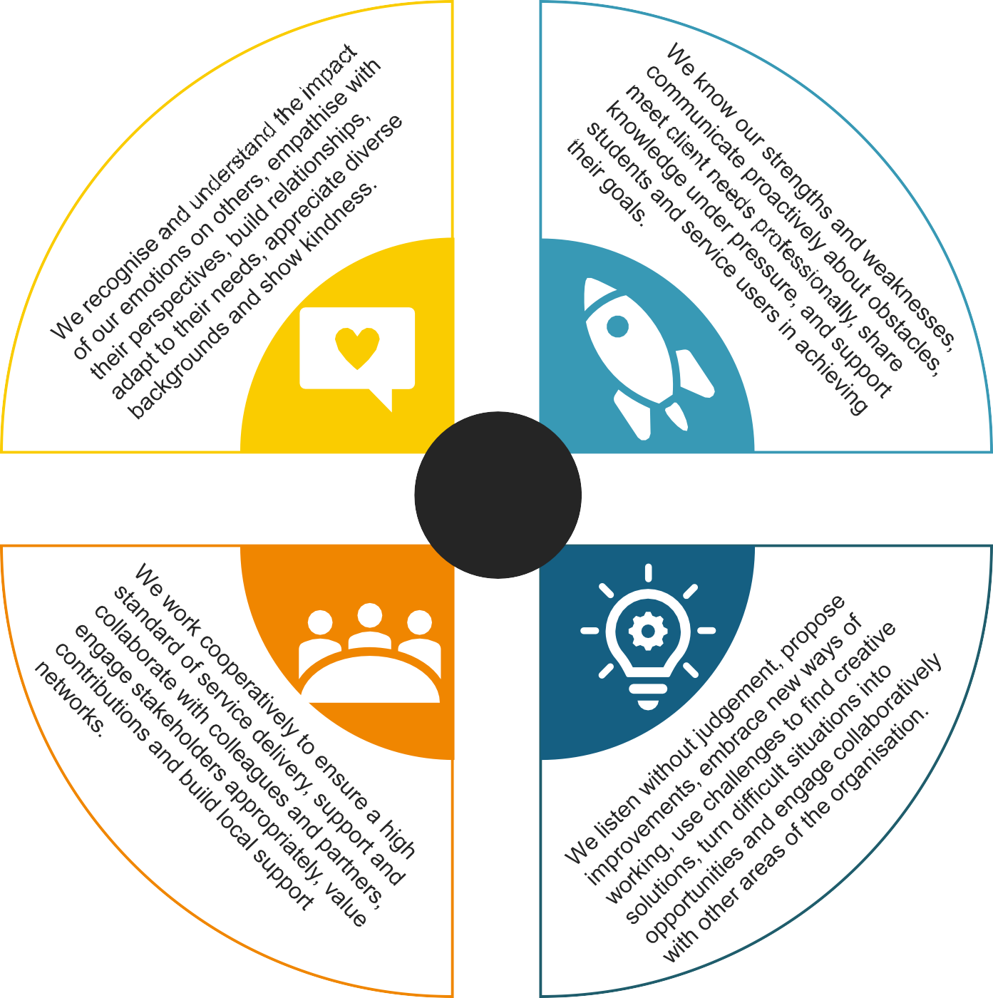



OUR BEHAVIOURS
Who we are at Catch22 is determined by ‘The How’ (our behaviours) and ‘The What’ (our capabilities and skills). Our Behaviour Framework (‘The How’) guides how we work, make decisions, and engage with others. It is important because it ensures our values are reflected in everything we do, helping us build trust, deliver consistently high-quality outcomes, and create a positive, inclusive workplace.
EMPOWER
COMPASSIONATE
VALUES
CURIOUS
COLLABORATIVE

Slide 8



OUR VALUES
Our values are at the heart of everything we do. They were created by colleagues across Catch22 and guide how we work together to support others.
We’re compassionate
We care about people, supporting them to move forward.
We empower others
We give people the knowledge, skills, and opportunities to thrive.
We’re
collaborative
We do things with people, not to them.
We’re curious
We explore, innovate, and challenge to improve what we do.
ADDITIONAL INFORMATION
The post holder will be required to comply with all policies and procedures issued by Catch22.
This job description cannot cover every issue or task that may arise within the post at various times and the post-holder will be expected to carry out other duties from time to time which are broadly consistent with those in this document.
This job description does not form part of the contract of employment.

