Slide 1

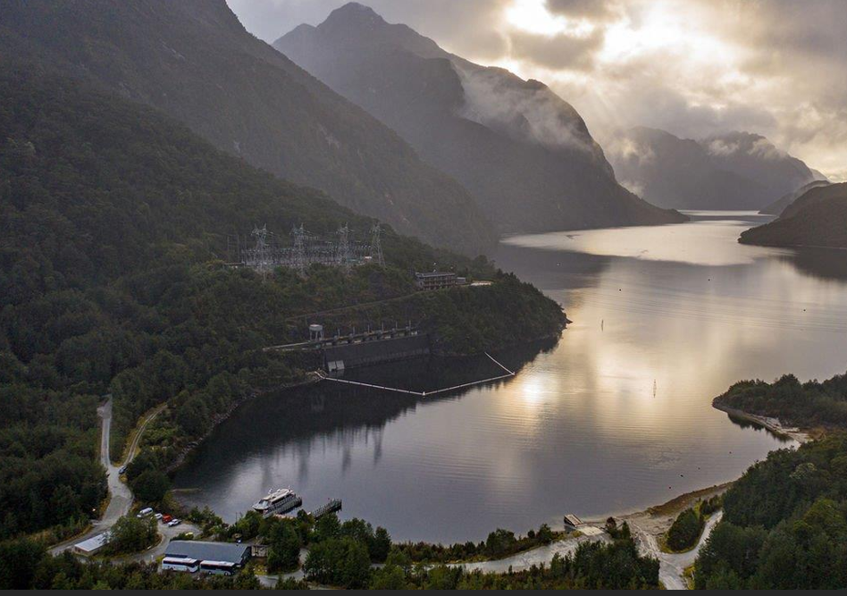
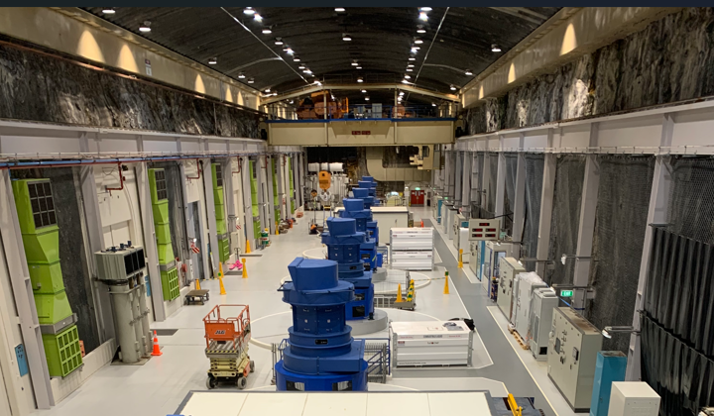

Position description
Site Project Delivery Manager (Manapouri)
Reporting to:
Programme Lead (Southland)
Date:
March 2026
Southland
Role Overview
Location is Southland (site-based) and reports to the Southland Programme Lead in Christchurch
Co-ordinate, schedule and oversee the execution of site works for key projects at the Manapouri Power Station
Key Responsibilities
Work closely with project managers, project engineers, planners, site teams & contractors to plan, schedule, co-ordinate and execute site project work across multiple work streams to ensure safe and quality outcomes are achieved
Review the site schedule of project works, in conjunction with planners and project managers, work with teams to understand priority, readiness, status and adjust as needed
Identify dependencies & risks, work with teams to manage and prepare work for execution
Plan and execute projects (if needed)
Facilitate and foster cross-functional team collaboration
Visible on site and the escalation point for site project work
Our purpose
Clean energy for a fairer and healthier world.
What we value Customers, Safety, Sustainability, People.
Our behaviours: ‘How to Be’ Be gutsy, Be a good human, Be in the waka.

Slide 2
Position description
Site Project Delivery Manager (Manapouri)
Reporting to:
Programme Lead (Southland)
Date:
March 2026
Southland
Candidate Profile
Qualifications; tertiary technical/engineering/project management/construction or other relevant qualifications preferred.
Extensive experience managing site works and work parties, with proven success in the delivery of complex and connected site works.
Proven leader with strong stakeholder management, excellent communication and inter-personnel skills
Software proficiency essential (MS office, Project, Sharepoint, Maximo, etc)
Experience in electricity industry is a plus
Key Performance Metrics
Safe, timely and quality delivery of site works to support priority projects
Successful safety compliance rate and audit results
High levels of stakeholder satisfaction
High levels of project team engagement
Operational readiness & delivery success rate
Our purpose
Clean energy for a fairer and healthier world.
What we value Customers, Safety, Sustainability, People.
Our behaviours: ‘How to Be’ Be gutsy, Be a good human, Be in the waka.

