Slide 1
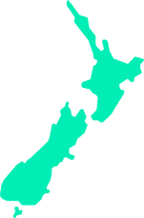
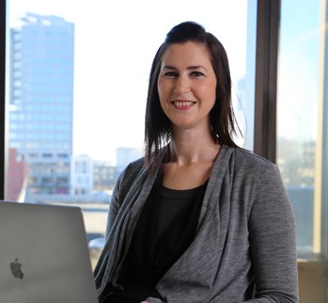
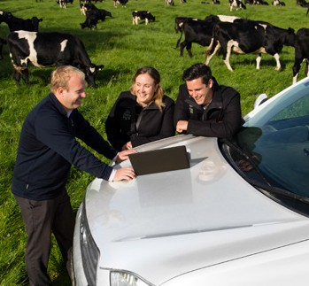
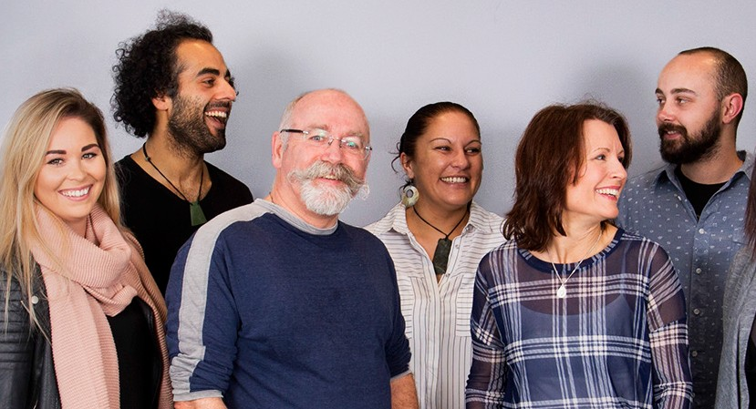
Position description:
Senior Data Engineer
Wellington
Reporting to:
Stream Lead Data, Analytics and Automation
Date:
February 2024
Christchurch
The role
The purpose of the Senior Data Engineer is to design, implement, and maintain data infrastructure and pipelines on the Databricks platform and ecosystem. This is a critical role that ensures the implementation of best engineering practices and the delivery of efficient and scalable data products.
Position accountabilities (What you’re responsible for)
Design, build, and maintain data pipelines on the Databricks platform.
Monitor and troubleshoot data pipelines to ensure data quality and integrity.
Play an active role in implementing data governance, security, and compliance in our Databricks platform and ecosystem.
Create and implement data engineering best practices across the entire data platform and analytics environment through DevSecOps culture and practices.
Stay up-to-date on emerging technologies and trends in the data engineering space and make recommendations for adoption.
Provide Level 2 & 3 support for the Databricks environment, including resolving data pipeline and data quality issues.
Out-of-hours support when required.
Contribute to roadmaps for enhancements to the modern data ecosystem.
Understand and cultivate strong relationships with the business to comprehend their future requirements and pain points.
Continued

Slide 2
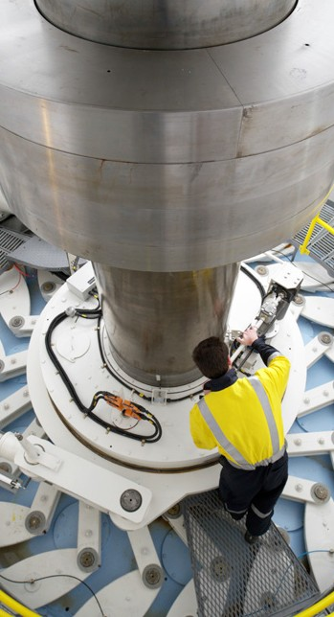
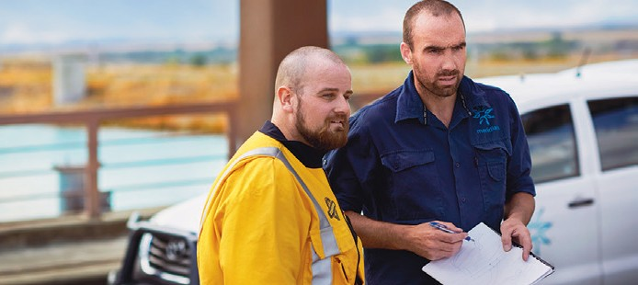
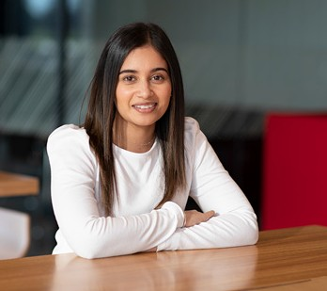
Candidate Profile
3+ years of experience in Databricks data engineering, with a focus on building and maintaining data pipelines and platforms.
A degree in computer science, software design, management information systems, mathematics/statistics/quantitative methods, or a related field, or relevant experience.
Knowledge, experience and skills
Experience working with large-scale datasets and real-time data processing.
Proficiency in Python.
Understanding of data governance, security, and compliance best practices.
Experience with the Azure cloud platform.
Strong written and verbal communication skills.
Analytical, creative, and innovative approach to problem-solving.
Experience with Azure Data Factory, Azure DevOps, DBT, Denodo, and Terraform will be advantageous.
Experience working in an Agile environment.
Personal Attributes
Constructive and collaborative working style
Excellent problem-solving skills.
Strong communication and documentation skills.
Keen attention to detail.
Our purpose
Clean energy for a fairer and healthier world.
What we value Customers, Safety, Sustainability, People.
Our behaviours: ‘How to Be’ Be gutsy, Be a good human, Be in the waka.

