Slide 1


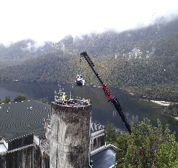
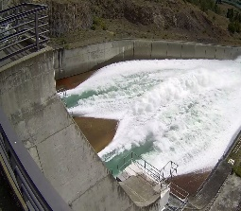
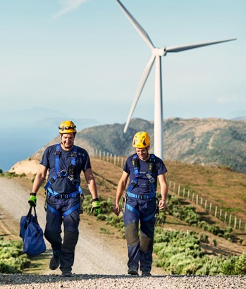

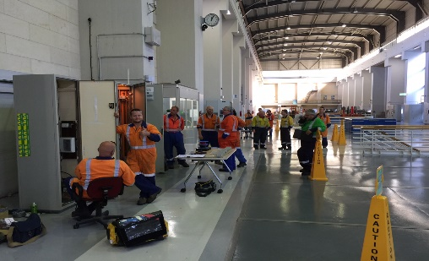

Position description:
Project Manager
Reporting to:
Project Practice Lead
Date:
June 2026
The role
This role is critical in delivering critical projects and project work packages across our Generation business. A key part of this role is and working collaboratively with key internal and external stakeholders and is pivotal in coordinating requirements between the Meridian project team, external site contractors, suppliers, internal strategic and tactical engineers, asset custodians, and operators.
Position accountabilities (What you’re responsible for)
Managing high value, complex projects and ensuring that planning, estimating, scheduling, resourcing and management of projects and work packages is undertaken and delivered to the agreed scope, quality, timeline and budget constraints.
Building constructive relationships with internal parties, such as Engineering and Maintenance teams, and external vendors and local Iwi, to ensure all project streams work together collaboratively to deliver the required outcomes in terms of quality, scope, time, and budget;
Undertaking contract tender and award which are compliant with the team and Meridian commercial requirements.
Ensuring contracts are administered in a manner that ensures the provisions of the contract remain fully enforceable.
Proactively leading the project H&S requirements by adhering to Meridian’s H&S policy, plans and procedures and ensuring the wellness of staff along with plant equipment and machinery is never compromised;
Ensuring health and safety requirements for projects are communicated to, and coordinated with, Asset maintenance teams and operation activities.
Collaborating with Health and Safety to ensure that all project related hazards have been identified and appropriate control measures are put in place.
Undertaking regular audits of the health and safety performances related to site activities in accordance with health and safety procedures and providing feedback on findings to those responsible.
Continued

Slide 2
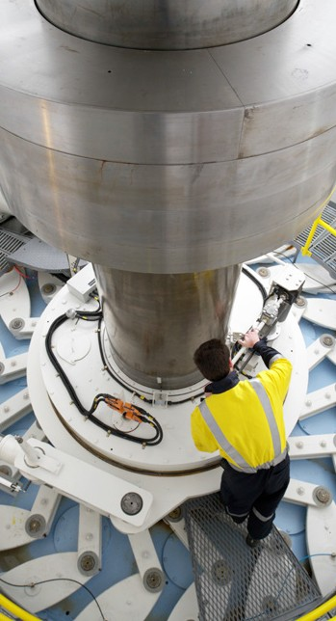
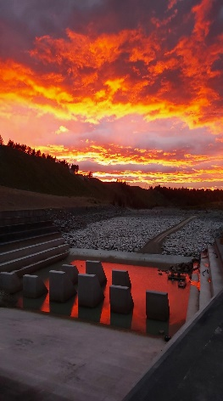
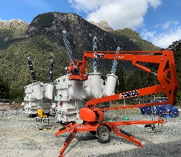
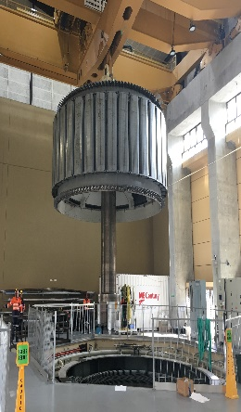
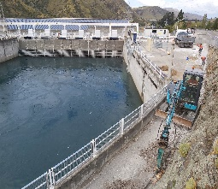
Analysing work procedures to ensure that all safety requirements have been identified and all persons involved are aware of the safe working methods.
Coordinating the project’s handover to operations including updating job plans, drawings, handbooks and operating procedures to reflect the project changes.
Coordinating the update of all station maintenance, operational documentation and training needs to meet the needs of the new project deliverables
Ensuring procurement processes / documentation are compliant with the Meridian’s commercial requirements.
Knowledge, experience and skills
Proven project management success in complex multi-disciplined projects involving civil, mechanical and/or electrical engineering construction works
Experience managing large, complex projects
Previous experience in effective management of health and safety risks;
Experience with project management IT applications including Microsoft Office, in particular MSP, Excel, Word.
Proven experience in managing contractors and/or coordinating similar complex design and integration projects;
Proven ability in applying innovative solutions to complex situations or challenges;
Excellent communication and relationship building skills.
Candidate profile
Education / qualifications
Formal Project Management qualifications and a comprehensive understanding of project management practices
A relevant tertiary qualification
Ideally a technical and/ or engineering background but not essential
Our purpose
Clean energy for a fairer and healthier world.
What we value Customers, Safety, Sustainability, People.
Our behaviours: ‘How to Be’ Be gutsy, Be a good human, Be in the waka.

