Slide 1
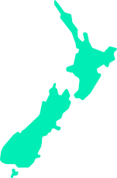
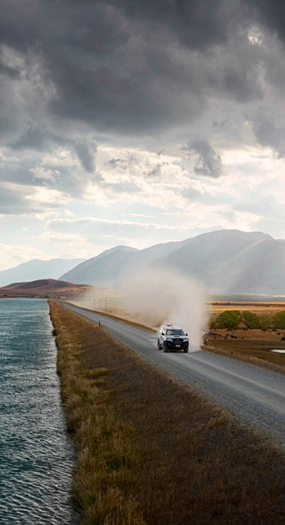
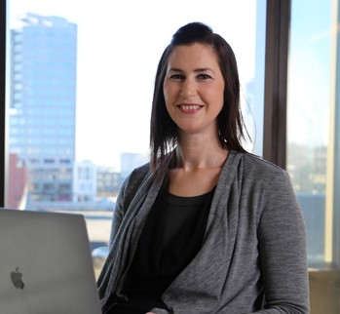

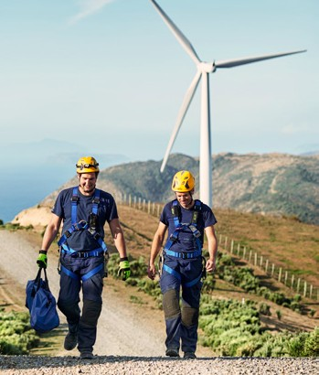
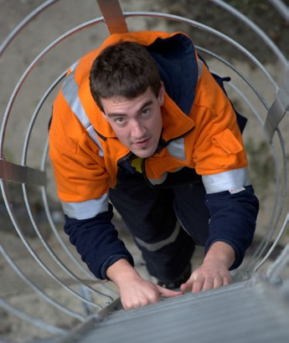
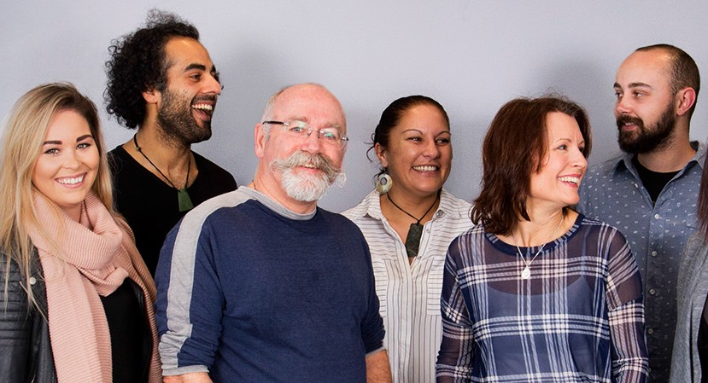

Position description:
Hydro Project Development Manager
Wellington
Reporting to:
Head of Hydro Development
Date:
September 2025
The role
You’ll deliver on hydro generation development projects as part of the Hydro Development Team. Depending on your experience and skills, you will focus on delivering new and/or additional flexible hydro generation and hydro storage opportunities into Meridian’s renewable generation portfolio, including projects that modify Meridian’s existing hydro reservoirs.
You’ll contribute to building the pipeline of project options from site identification, landowner engagement, concept through to consent, including feasibility studies, preliminary design work, resource consent applications. You will ensure transfer of information into the detailed design and business case team, and construction team, continuing to assist as necessary.
You will contribute to the wider remit and IP of the Development Team and other Meridian wide projects as required. You’ll help ensure high quality and cost-effective projects are prepared to support Meridian’s generation pipeline aspirations, role in the path to a low carbon economy and delivery of strong return for Meridian shareholders.
Position accountabilities (What you’re responsible for)
Delivering and contributing to preparation of high quality and cost-effective project development options, focusing on hydro opportunities within and beyond our existing catchments
Assisting in site prospecting with a focus on site identification, feasibility studies and securing land access
Identifying significant risks to the development of projects and developing and proposing executable strategies to eliminate or mitigate them
Negotiating appropriate contracts and managing both internal and external specialists/consultants involved with project development
Securing resource consents for sites and developing appropriate strategies and plans for their successful implementation
Managing development budgets in excess of $1 million
Continued

Slide 2
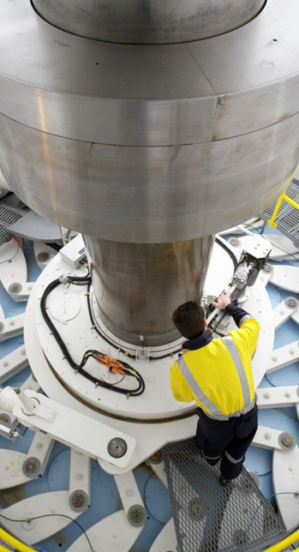
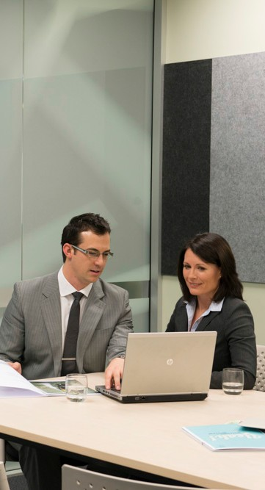
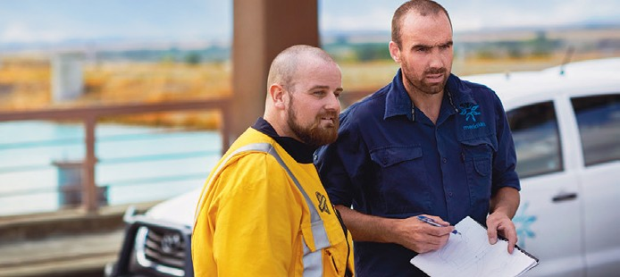
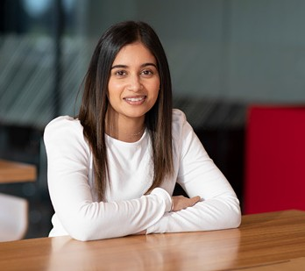

Knowledge, experience and skills
4 years’ to 20+ years’ experience, particularly in hydro generation development from pre-feasibility onward
Understanding of hydro generation technology
Solid ability to adapt to emerging technologies and processes associated with hydro generation development
Strong project management experience
Financial planning and management expertise
Ability in stakeholder management and planning approvals process
High-level stakeholder engagement and communication skills
Experience at selecting/managing consultants and contractors
Ability in contract formulation, negotiation and management
Team player
Ability to operate comfortably within an environment of significant uncertainty, with long development lead times
Manage competing demands and pressures in a constructive manner
Supporting the development of the project plan through to consent approval, and ensuring handover for detailed design and business case, with ongoing input as required
Focussing on strong internal/external relationships and communication networks in order to ensure that the development projects are well supported and understood, in particular with: public relations and communications, transmission and electrical (where appropriate), and consenting
Supporting the team’s refinement of our development projects’ economics. This will include managing design consultants to develop parameters for more robust project costings in support of project business cases
Candidate profile
Education / qualifications
Preferred tertiary qualification in engineering, sciences, project management, RMA or environmental planning related disciplines
Our purpose
Clean energy for a fairer and healthier world.
What we value Customers, Safety, Sustainability, People.
Our behaviours: ‘How to Be’ Be gutsy, Be a good human, Be in the waka.

