Slide 1
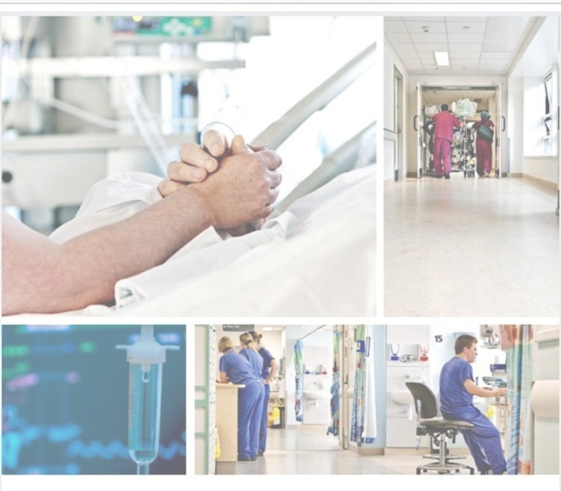

We’re Recruiting
Consultant in Critical Care

Slide 2
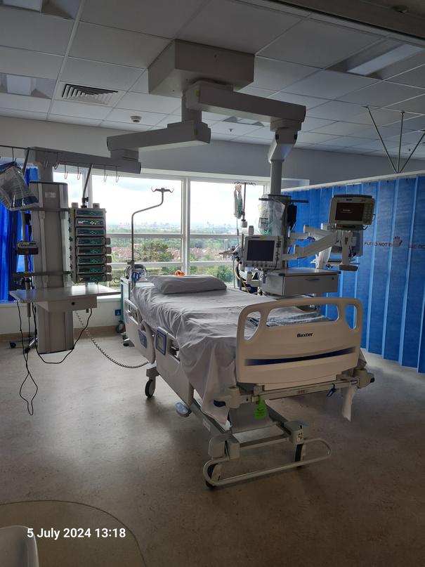
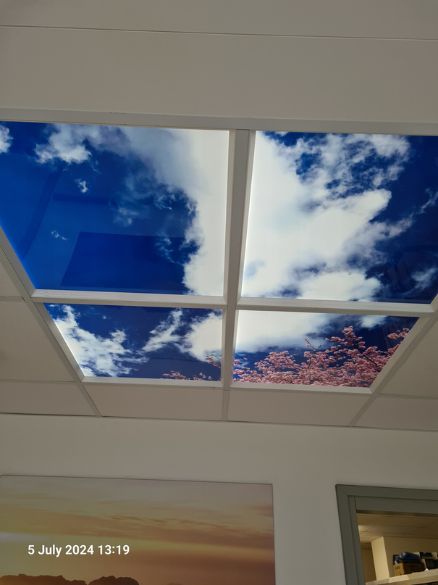
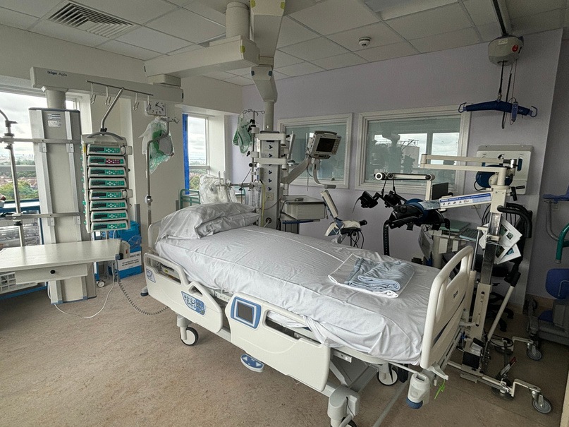
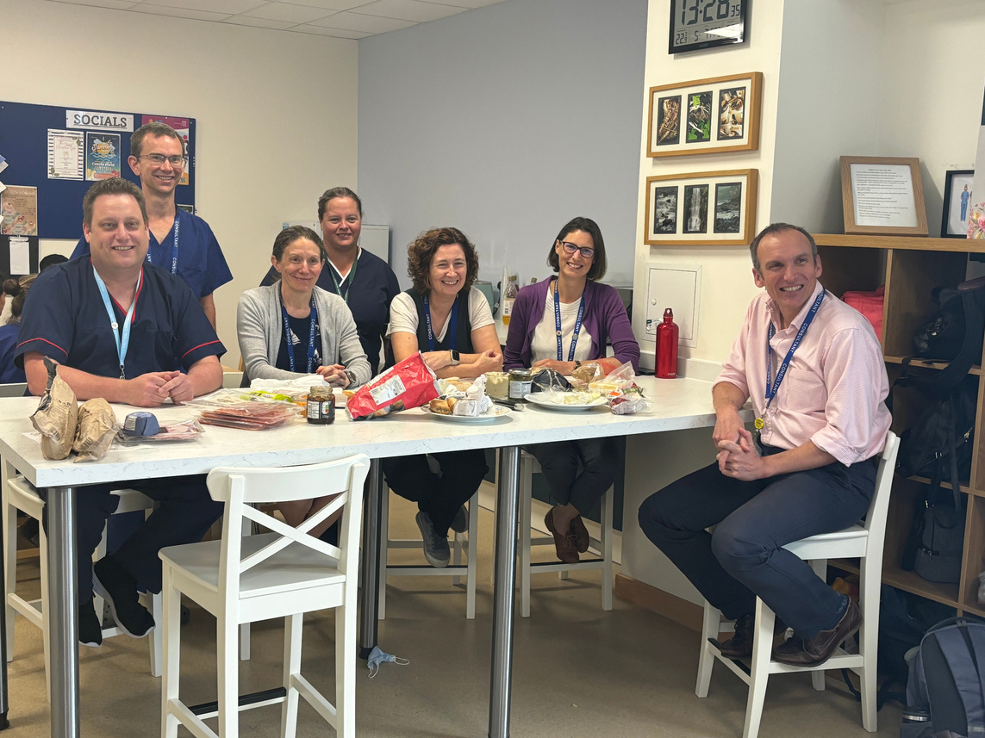
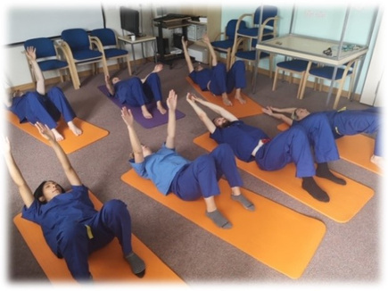
About our Intensive Care Unit
Our Critical Care unit admits around 1500 patients/year into 19 funded Level 3 equivalent beds (using a maximum of 24 physical bed spaces). In addition to general intensive care admissions, we also support specific specialities such as upper GI surgery, complex head and neck surgery and the Wessex Regional Renal and Transplant Unit. Although admissions are predominately adult, the unit has the facilities to admit paediatric patients for limited critical care support. The unit provides paediatric stabilisation and if needed transfer to the regional PICU.
Our department was awarded an “outstanding” rating in all domains following a CQC visit in 2018. This was retained at the most recent inspection. We continue to be ambitious and are always looking for opportunities to improve our standards, safety, and training, to provide the very best care and experience for our patients, relatives, and staff.
We are a department that embraces innovation and have a national reputation for use of digital technology in healthcare. We have been a ‘paperless’ unit for over 10 years and have just launched our 3rd generation Clinical Information System and are supported by an in-house IT team.
The department is well resourced with a wide range of ventilatory options and current model CRRT machines. A large fleet of ultrasound and ECHO machines support clinical practices as well as consultant led education and training (FUSIC).
We are supported by a dedicated critical care pharmacy team who also attend ward rounds. We have a core team of physiotherapists who receive support from a critical care occupational therapist. A dietician is also embedded in the unit. Our staff, patients and relatives are supported by our own clinical psychologist.
We have a well-established team of Advanced Critical Care practitioners comprised of ACCPs ranging from those that have been qualified for some years through to those in training on a structured and supported training pathway.

Slide 3
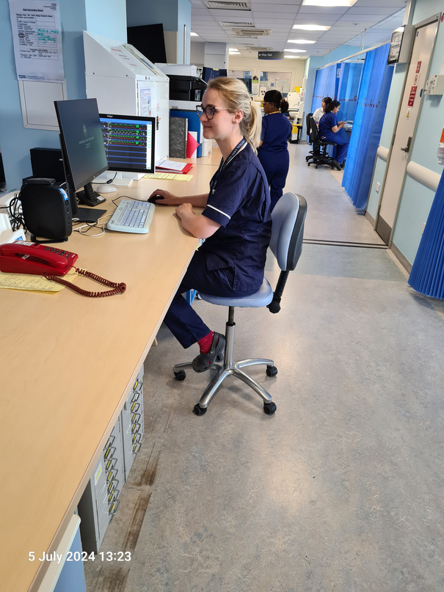
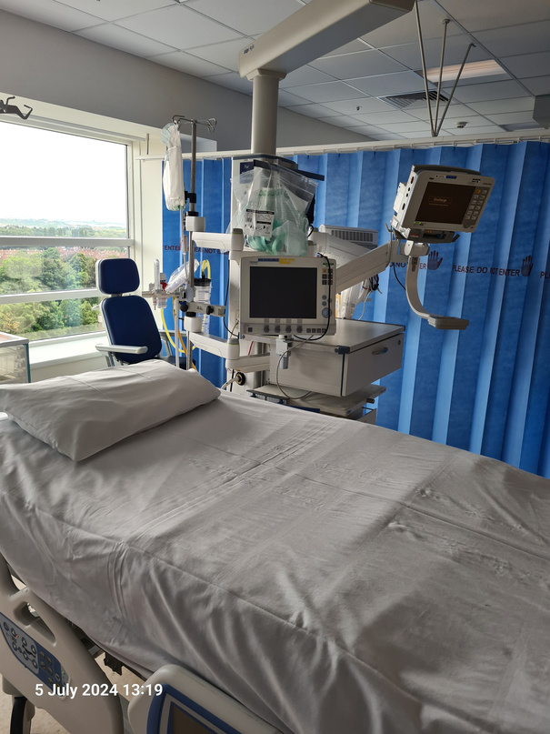
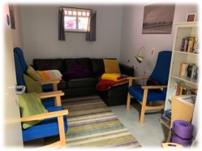
The department has a comprehensive and well respected teaching program with trainees having protected time for teaching. All members of the multi-disciplinary team are invited to join teaching sessions. The post holder would be expected to participate in education, training and supervision of trainees and other members of the MDT.
We are extremely active and effective in research. We are amongst the top recruiting ICUs across the UK with patients recruited to high complexity studies across a range of conditions. We have been amongst the most active recruiting sites for Urgent Public Health studies in the Covid pandemic. Research is fully embedded in daily activity with a dedicated research team and involvement of the consultant body and AHPs as Co-investigators and the unit is actively sought to take part in novel studies because of our cohesive approach and record of successful recruitment to trials.
In 2013 the department formed a new collaborative partnership with the University of Portsmouth and became an academic department. These close links with the University were then consolidated with the Trust being awarded University status in 2020. The department supports undergraduate education and this will expand as the trust supports the development of a new medical school. The first intake of students are expected in 2024.
There is a strong team ethos within the department with a focus on staff well-being. A recently refurbished staff coffee area and relaxation/wellness room are both within the department footprint. There is a Wellness Centre on the PHU site with a swimming pool and gym.

Slide 4
The job plan will include up to 10 programmed activities (PAs)/week. All job plans are annualised. Our consultants have come through a range of training pathways with either duel training (including anaesthetics, ED, respiratory, acute medicine, renal) or as a single ICM CCT. The posts are appointed by and based in Critical Care, but sessions in a base Specialty (up to 2 PAs) are possible. Supporting Professional Activities will account for 2 PAs.
Consultants are supported to pursue their own speciality interests both within and outside the PHU critical care unit. Our consultant group have strong educational links supporting both in house education and training as well as regional and national training boards. Consultants are involved with several speciality groups and projects both within the trust, regionally as well as nationally. Where possible, consultants are supported to maintain their own speciality interests outside of PHU, for example as part of an ECMO retrieval team or the regional transfer team.
Departmental vision:
Best possible Care & Outcome for our critically ill patients
Protect, & preserve Dignity through critical illness
Safety & Quality at the heart of everything we do
Support families & loved ones
Highest quality Training & Development for our staff
Above all, we are looking for a new colleague to contribute to our outstanding department, (as evidenced by CQC report) by maintaining the quality, standards, training and culture of safety and learning in order to provide the best possible care for our patients. If you are looking for a department, where people are treated with compassion, kindness, dignity and respect

Slide 5
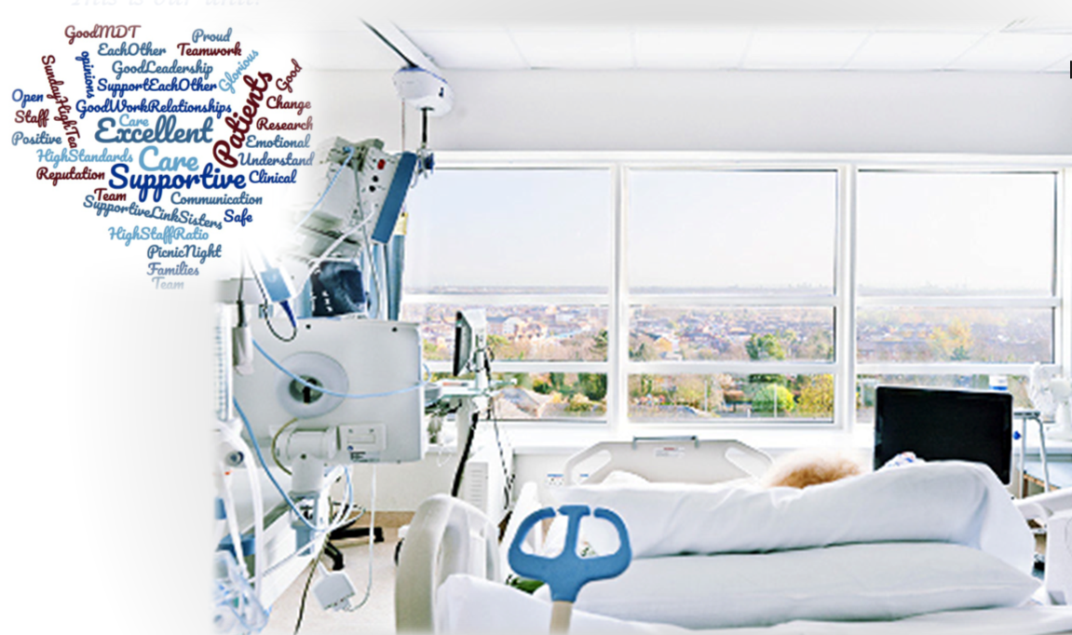

Slide 6
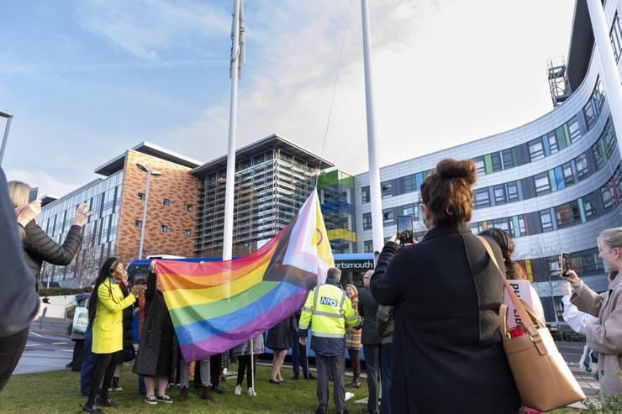
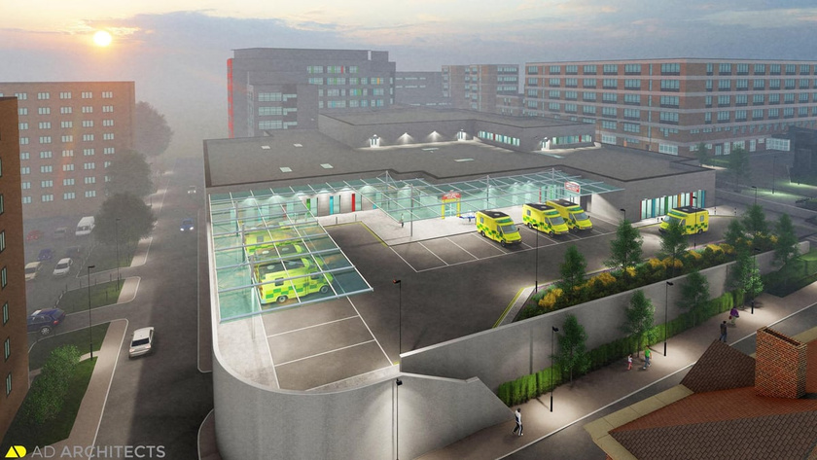
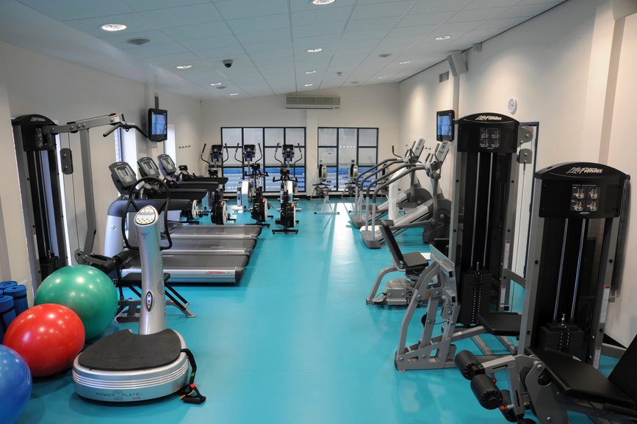
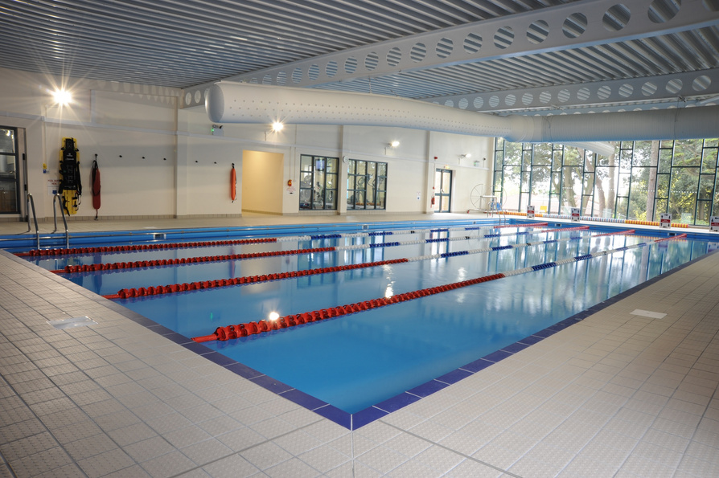
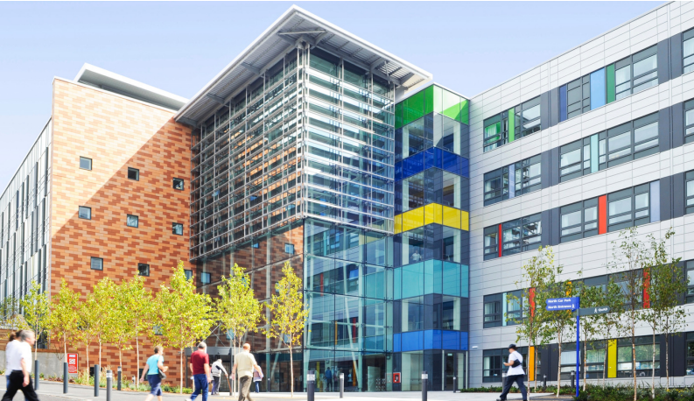
About Portsmouth Hospitals University NHS Trust
With a turnover of £800m, PHU provides comprehensive secondary care and a number of specialist services to a local population of 675,000 people across South-east Hampshire. We also offer some tertiary services (including the Wessex Renal and Transplant Unit) to a wider catchment in excess of two million people. The Trust employs over 8,732 staff and is the largest employer in Portsmouth.
Supported by £58 million of national funding, our new Emergency Department (ED) will provide a range of improved facilities for adults and children across Portsmouth and the surrounding area. It will have better access for ambulances with a covered handover area, as well as designated drop off zone for patients.
https://www.youtube.com/watch?v=3FKsWWIbpEU
PHU is a major provider of undergraduate and postgraduate education, working with three universities (Southampton, Portsmouth and Bournemouth). Our hospital also hosts the largest of five Joint Hospital Groups in England. Personnel from all three-Armed Services are fully integrated within the Trust, working alongside their civilian counterparts, helping to treat and care for patients from the local and surrounding communities.
At the core of Portsmouth Hospitals University NHS Trust culture is the value we place on our workforce; their skills, knowledge, experience and contribution to the communities we serve. We are proud to offer our staff more than just a job – we offer them an opportunity to be part of a dynamic organisation striving for excellence which provides its staff members with benefits and support throughout their lives and careers.
We are pleased to be able to offer benefits ranging from reduced cost lease cars, flexible working and an onsite nursery to apprenticeships and development opportunities to get the most from your career with us. We understand that a career is about more than just the time you spend at work and so we aim to provide a flexible and supportive environment for our staff.

Slide 7
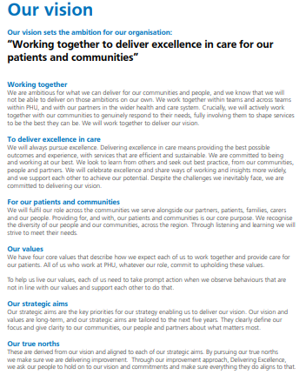
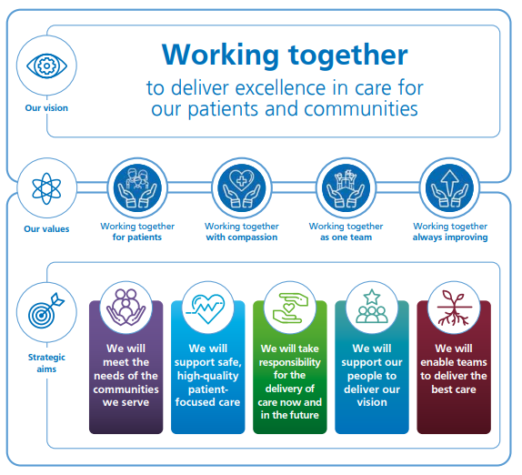

Slide 8
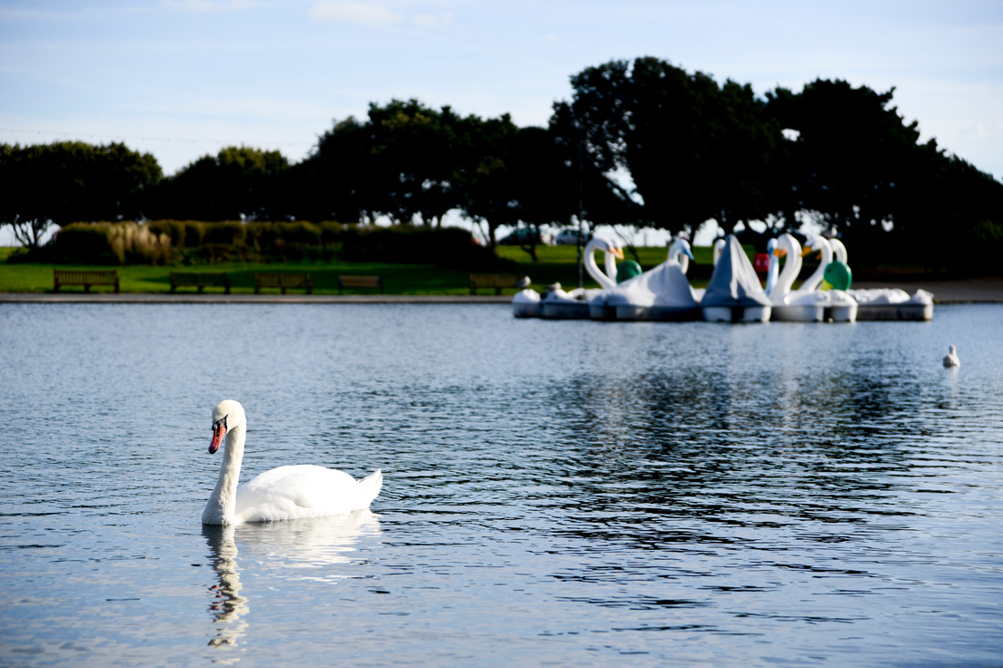

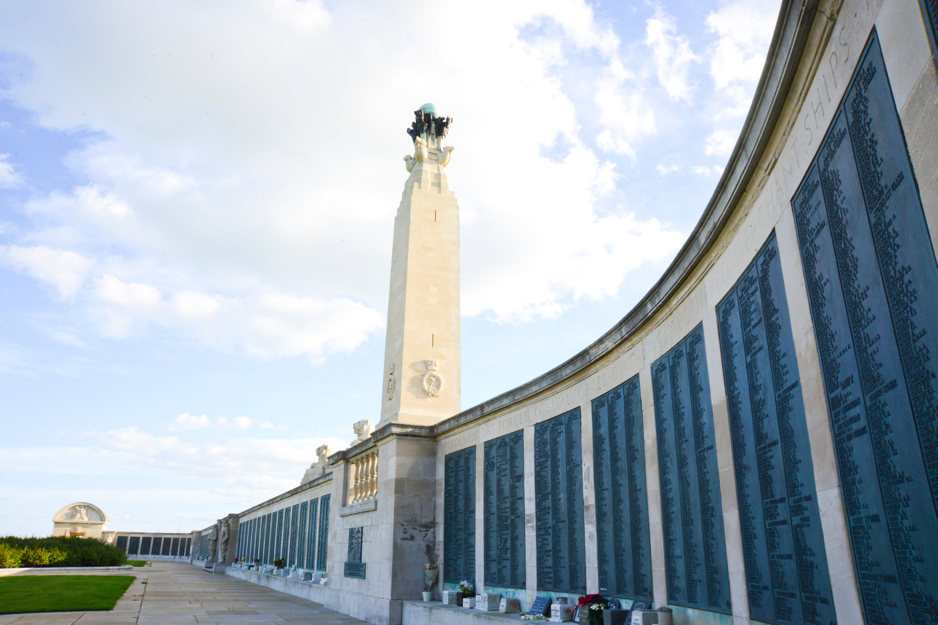
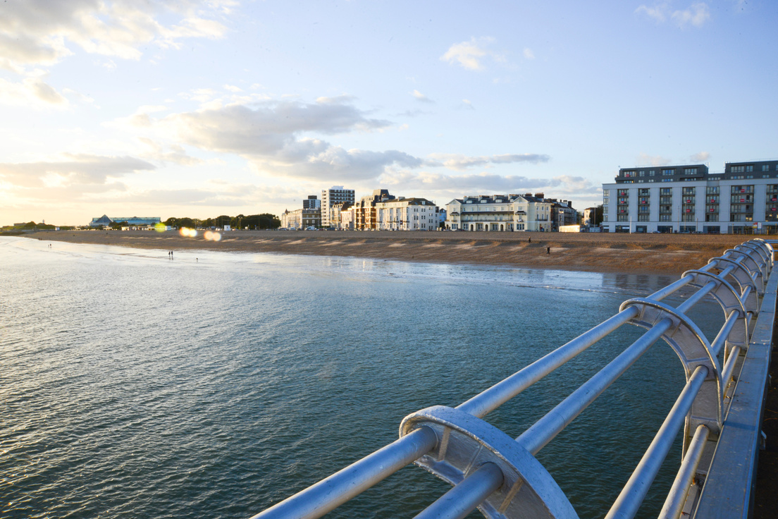
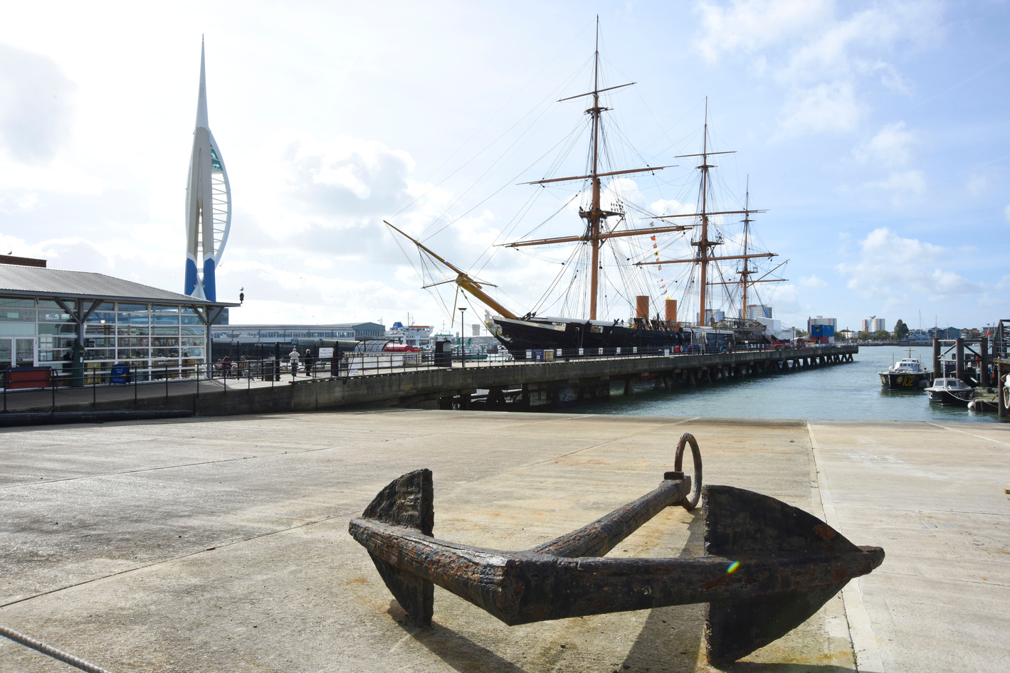
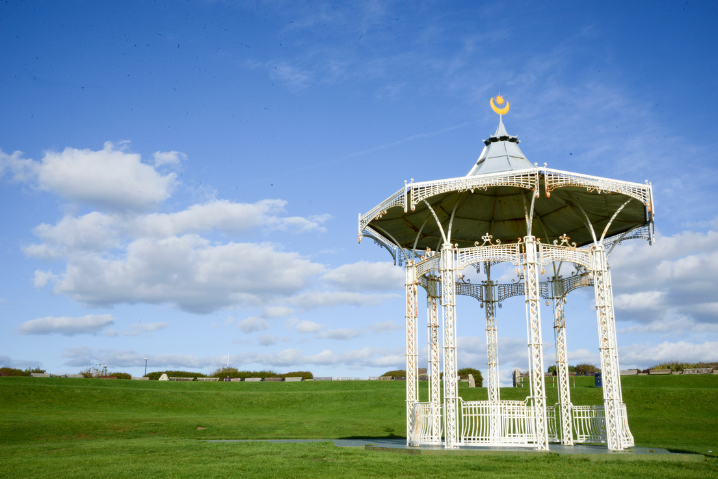

Location
Portsmouth is the second largest city in Hampshire on the south coast of England. Notable for being the United Kingdom's only island city, Portsmouth is located mainly on Portsea Island. It is a most appealing location, with stunning sea views from the Southsea seafront, where the four miles of beach are backed by the green spaces of Southsea Common. Adding to the “feel good” factor, Portsmouth receives more sunshine per annum than most of the UK and is much milder, with Portsdown Hill to the North deflecting cold winds.
The South Coast is a great place to live and work, benefiting from easy access to London by rail and road. Whether it’s the tranquillity of the Isle of Wight, the historic naval character of Portsmouth, Southampton or the New Forest, the area has much to offer. Southampton Airport is close by with flights to both domestic and international destinations and direct cross-channel ferry services to France and Spain are also just moments away.
The City of Portsmouth has a population of over 238,000 and the Portsmouth Urban Area, which includes Fareham, Portchester, Gosport and Havant is the 14th largest urban area in the United Kingdom, Portsmouth combines with Southampton to form a single metropolitan area with a population of over a million. Portsmouth is situated 64 miles (103 km) south west from London and 19 miles (31 km) south east of Southampton.
As a significant naval port for centuries, Portsmouth is peppered with fascinating architecture portraying its rich history and inspiring characters like Admiral Nelson and Charles Dickens. England’s naval reliance on Portsmouth led to the city becoming the most fortified in Europe. Many of the city's impressive former defences now host museums or events and are popular city attractions. In the historic dockyard lies HMS Victory, the Mary Rose and HMS Warrior.
Bringing it right up to date Portsmouth has benefited from major investment, widespread redevelopment and a buoyant local economy. Portsmouth now offers impressive new locations, proving highly attractive for relocations.The city has two theatres with wide ranging programmes including an increasing number of national tours. The Portsmouth Guildhall hosts numerous musical events along with various other established music venues.

Slide 9



