Slide 1


Sales Consultant
Public Sector Team
Sales Role
Competitive Salary & Commission
Company Vehicle
Company Profit Share and Benefits
Coverage : Leeds & Surrounding Area’s
What will I be doing?
Stannah has a world class reputation for treating all of its customers with upmost respect and offering a world class service. Nothing is too much. Whenever you are dealing with a Local Authority, the customer is Stannah’s reason for being.
As a Sales Consultant for the Public Sector Team you will be responsible for the profitable achievement of stairlift sales targets and to provide a customer focused solution throughout the sales process.
As part of this role, you will:
Work to achieve forecast sales and other targets that may be set by Sales Management Team
Find and nurture sales opportunities in the territory.
Enhance our business by building new relationships and opportunities.
Maintain long-term relationships with Local Authority stakeholders.
Gain a thorough understanding of Stannah solutions to sell in a competitive situation.
Manage your own diary by arranging suitable appointments with customers
Enhance our business by building new relationships and opportunities.
Complete quotations and surveys based on the needs of the client and in line with site and risk assessment.
Maintain the highest standards of professionalism, honesty, trust, integrity and safety in keeping with the Company’s position as market leader.
Positively support and participate in any business development, training or project activity as requested by Sales Management.
Provide cover for Public Sector Sales Consultant colleague accounts when required by Company needs.
Attend and actively contribute to sales meetings and training sessions.

Slide 2


Is this job for me?
Stannah is the leading UK brand in homelifts and stairlifts, customers love the brand because of our company values and excellent customer service. As a Sales Consultant in our Public Sector Team, it is important that you relate and commit to these values so that our customers feel them when dealing with you. Stannah has well-developed successful procedures in place to help you succeed and you will work with support of strong management teams to ensure success.
Reporting to the Regional Sales Manager you will be expected to maintain close and effective personal working relationships at all levels of the organisation. The communication skills required include the ability to communicate technical, complex, and sensitive information with external agencies including Local Authorities, Housing Associations, RSL’s, ALMO’s Framework Organisations, Sub-Contractors and 3rd party product suppliers.
What skills do I need?
To succeed in the Sales Consultant role, you will need;
Proven track record in sales and account management, within UK Public Sector.
To be driven and tenacious to find sales opportunities.
Travel extensively within the territory
Confident written and verbal communication skills with a friendly and positive approach.
Ability to develop a deep knowledge of Stannah group business ventures and services, competitors, relationships with customers, clients and suppliers, market evolution
Proficiency in Outlook, Teams.
Must be a good team player who is open to working closely with sales colleagues and individuals from other departments
Experience of working with CRM systems.
Empathetic to Public Sector challenges
Other Requirements
Full and Clean Driving Licence.
To be able to work from a home environment
When required by business needs, to stay away from home overnight
GCSE Maths and English C grade and above (or equivalent)

Slide 3
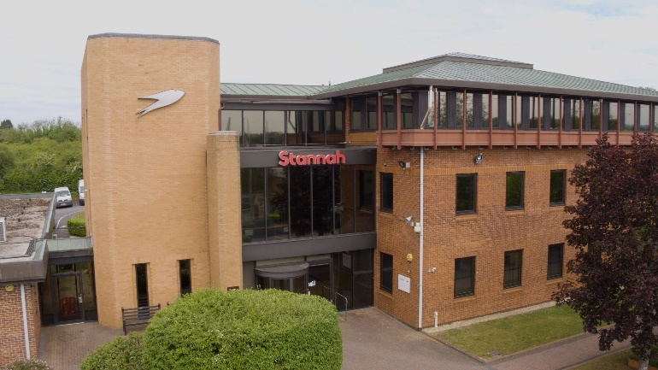


Who is Stannah?
Stannah is a global leading business producing homelifts and stairlifts. It is highly successful UK business, now leading globally in its field. Over 150 years old and still independent, proudly run by the Stannah family and the fantastic Stannah teams.
Stannah is known by customers for its quality of product and service. It is respected by customers as a company and brand to rely on.
Stannah’s core values can be felt right throughout the company and by its customers. It leads as an ethical and successful business with high morals.
Stannah has an enviable ‘one team’ approach which makes the customer journey excellent.
Where in the world of Stannah will I be working?
You will be working in the UK Stairlift & Homelift Public Sector Team. Working with your Public Sector Stakeholders you will take pride in adapting homes to make them safer for our customers. Stairlift solutions significantly contribute to an individual’s independence, privacy and dignity. The role of a Stannah Sales Consultant is a rewarding, one that is shared globally by your colleagues.
Stannah values
We take care of our customers
People are at the heart of our business
We respect our suppliers
We strive to continue to improve

