Slide 1
Distribution Platform
Objective: Grow the business – Achieve targets
E6 Platform: Vision
The Element Six Platform provides an unlimited knowledge base, makes all relevant information available on a daily basis and answers all questions immediately, 24 hours a day and 7 days a week. It supports the development towards a value added distribution with a clear focus on our customers and their needs worldwide.
E6 Platform: Mission
Provide Distributors and customers with the information they need, at any time
Improve/ Streamline our internal processes
Self-service Platform and changing Distributor behaviour

Slide 2
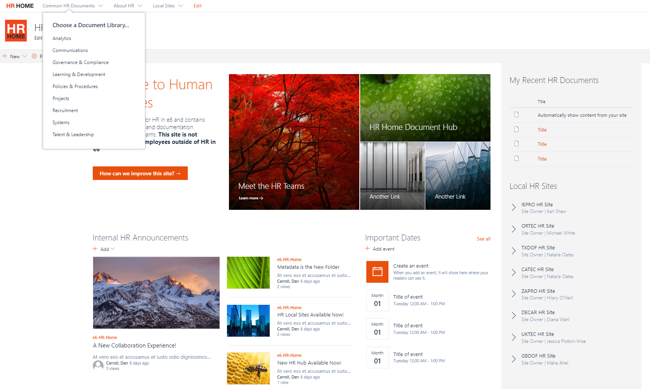
IM Work Stream: Distributor Platform: example
Customer/Distributor login to ensure security is adhered to
Platform
Sales & Marketing Collateral
Media Library
Inventory Enquiry
Order Entry
Element Six News
Element Six Contacts, per distributor
Frequently Asked Questions (FAQ)
Contracts via E Signature & Workflow
Pricing Enhancements

Slide 3
Distributor Platform Key areas
Content
Presentations
Product related documents
Education
Training Modules
Self-learning portal
Marketing
Availability
Performance
CSC
Vision, Mission, Strategy
Campaigns
Mobilization
Actual Stock information
Contracts
Individual Targets
Order Status
Order Platform
Lead Generation
Web page content
Gift shop
Lead times
General Porfolio
Achievement levels
FOC Portal
Pricing
Quotations
Price Lists
Online Configurator
CQ Portal
Application related Documents
Project Portal
Interactive
Chat functionality
Upload functionality
FAQ
Advanced technical Documentation
Drawings

